Slide 1
HTML-The Hypertext Markup Language
The basis of the Web is transferring Web pages from server to client. In the simplest form, Web pages are static, that is, are just files sitting on some server waiting to be retrieved.
In this context, even a video is a static Web page because it is just a file.
Web pages are currently written in a language called HTML (HyperText Markup Language). HTML allows users to produce Web pages that include text, graphics, and pointers to other Web pages.
HTML is a markup language, a language for describing how documents are to be formatted. The term ''markup'' comes from the old days when copyeditors actually marked up documents to tell the printer—in those days, a human being—which fonts to use, and so on.
Markup languages thus contain explicit commands for formatting. For example, in HTML, <b> means start boldface mode, and </b> means leave boldface mode.
The advantage of a markup language over one with no explicit markup is that writing a browser for it is straightforward: the browser simply has to understand the markup commands.
TeX and troff are other well-known examples of markup languages.

Slide 2
HTML-The Hypertext Markup Language
The basis of the Web is transferring Web pages from server to client. In the simplest form, Web pages are static, that is, are just files sitting on some server waiting to be retrieved.
In this context, even a video is a static Web page because it is just a file.
Web pages are currently written in a language called HTML (HyperText Markup Language). HTML allows users to produce Web pages that include text, graphics, and pointers to other Web pages.
HTML is a markup language, a language for describing how documents are to be formatted. The term ''markup'' comes from the old days when copyeditors actually marked up documents to tell the printer—in those days, a human being—which fonts to use, and so on.
Markup languages thus contain explicit commands for formatting. For example, in HTML, <b> means start boldface mode, and </b> means leave boldface mode.
The advantage of a markup language over one with no explicit markup is that writing a browser for it is straightforward: the browser simply has to understand the markup commands.
TeX and troff are other well-known examples of markup languages.

Slide 3
HTML-The Hypertext Markup Language
A Web page consists of a head and a body, each enclosed by <html> and </html> tags (formatting commands), although most browsers do not complain if these tags are missing.
The head is bracketed by the <head> and </head> tags and the body is bracketed by the <body> and </body> tags.
The strings inside the tags are called directives. Most HTML tags have this format, that is they use, <something> to mark the beginning of something and </something> to mark its end.
Most browsers have a menu item VIEW SOURCE or something like that. Selecting this item displays the current page's HTML source, instead of its formatted output.

Slide 4
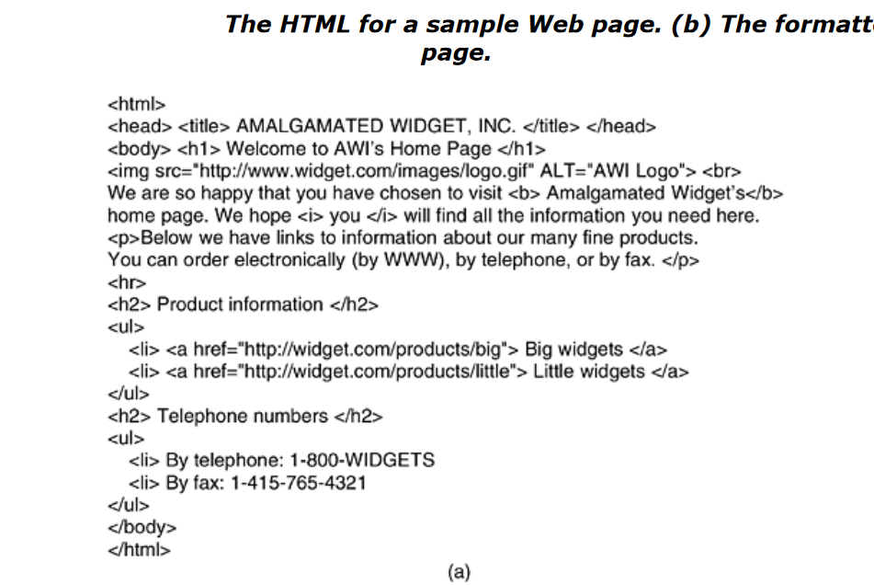
HTML-The Hypertext Markup Language

Slide 5
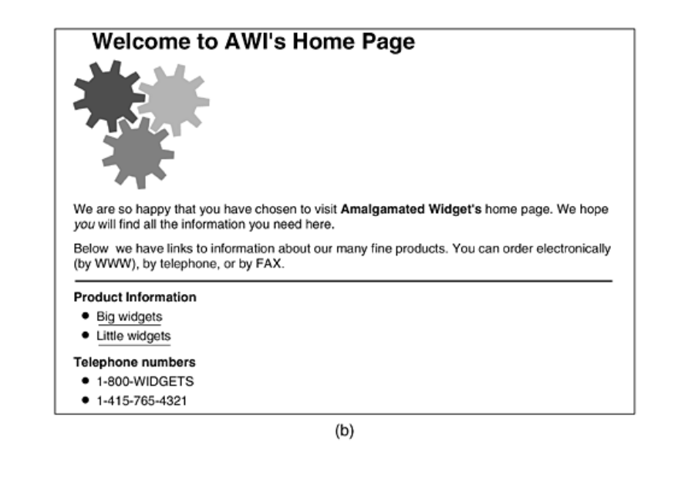
HTML-The Hypertext Markup Language

Slide 6
HTML-The Hypertext Markup Language
Tags can be in either lower case or upper case. Thus, <head> and <HEAD> mean the same thing, but newer versions of the standard require lower case only.
HTML parsers ignore extra spaces and carriage returns since they have to reformat the text to make it fit the current display area.
Consequently, white space can be added at will to make HTML documents more readable, something most of them are badly in need of.
As another consequence, blank lines cannot be used to separate paragraphs, as they are simply ignored. An explicit tag is required.
Some tags have (named) parameters, called attributes. For example,
<img src="abc" alt="foobar"> is a tag, <img>, with parameter src set equal to abc and parameter alt set equal to foobar.

Slide 7
HTML-The Hypertext Markup Language
For each tag, the HTML standard gives a list of what the permitted parameters, if any, are, and what they mean. Because each parameter is named, the order in which the parameters are given is not significant.
The list of special characters is given in the standard. All of them begin with an ampersand and end with a semicolon.
For example, &nbsp; produces a space, &egrave; produces è and &eacute; produces é. Since <, >, and & have special meanings, they can be expressed only with their escape sequences, &lt;, &gt;, and &amp;, respectively.
The main item in the head is the title, delimited by <title> and </title>, but certain kinds of meta-information may also be present. The title itself is not displayed on the page.
Headings are generated by an <hn>tag, where n is a digit in the range 1 to 6. Thus <h1> is the most important heading; <h6> is the least important one.
It is up to the browser to render these appropriately on the screen. Typically the lower numbered headings will be displayed in a larger and heavier font.
The browser may also choose to use different colors for each level of heading. Typically <h1> headings are large and boldface with at least one blank line above and below.

Slide 8
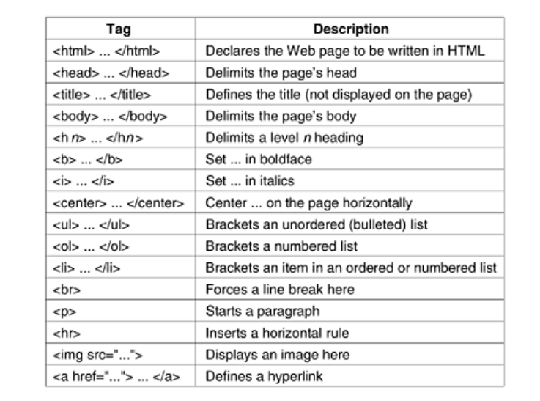
HTML-The Hypertext Markup Language

Slide 9
HTTP-The Hypertext Transfer Protocol
HTTP (Hypertext Transfer Protocol) is the foundational protocol used for transmitting data over the web. It defines how messages are formatted and transmitted, and how web servers and browsers should respond to various commands. Here’s an in-depth look at HTTP, its components, methods, and how it works:
HTTP Overview
HTTP is an application-layer protocol that enables communication between clients (such as web browsers) and servers. It operates over TCP (Transmission Control Protocol), ensuring reliable data transfer.
Key Concepts
Request and Response Model:
HTTP operates on a request-response model where a client sends an HTTP request to a server, and the server responds with an HTTP response.
Stateless:
HTTP is stateless, meaning each request from a client to a server is independent and does not retain any state information from previous requests.
Text-Based Protocol:
HTTP messages are text-based, which makes them easy to read and debug. They consist of headers and a body.

Slide 10
HTTP-The Hypertext Transfer Protocol
HTTP Request
An HTTP request from a client (e.g., a web browser) to a server consists of:
Request Line:
Includes the method, the resource URL, and the HTTP version.
Example: GET /index.html HTTP/1.1
Headers:
Provide additional information about the request, such as browser type, accepted content types, and more.
Example:
makefile
Host: www.example.com User-Agent: Mozilla/5.0 Accept: text/html,application/xhtml+xml
Body (Optional):
Contains data sent to the server, typically used with methods like POST to submit form data.
Example (for a POST request):

Slide 11
HTTP-The Hypertext Transfer Protocol
HTTP Methods
HTTP defines several methods, each serving a different purpose:
GET:
Requests data from a specified resource.
Example: GET /index.html
POST:
Submits data to be processed by a specified resource (e.g., form submission).
Example: POST /submit-form
PUT:
Updates or creates a resource at the specified URL.
Example: PUT /update-item
DELETE:
Deletes the specified resource.
Example: DELETE /remove-item

Slide 12
HTTP-The Hypertext Transfer Protocol
HTTP Methods
HEAD:
Retrieves the headers of a specified resource, similar to GET but without the body.
Example: HEAD /index.html
OPTIONS:
Describes the communication options for the target resource.
Example: OPTIONS /api
PATCH:
Partially updates a resource.
Example: PATCH /update-item

Slide 13
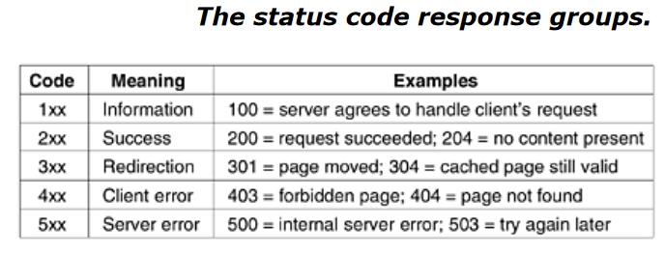
HTTP-The Hypertext Transfer Protocol

Slide 14
HTTP-The Hypertext Transfer Protocol
HTTP Status Codes
Status codes in HTTP responses indicate the outcome of the request. They are grouped into five classes:
1xx (Informational):
Example: 100 Continue
2xx (Successful):
Example: 200 OK (Request succeeded)
Example: 201 Created (Resource created successfully)
3xx (Redirection):
Example: 301 Moved Permanently (Resource moved to a new URL)
Example: 302 Found (Resource temporarily moved)
4xx (Client Error):
Example: 400 Bad Request (Malformed request)
Example: 404 Not Found (Resource not found)
5xx (Server Error):
Example: 500 Internal Server Error (Server encountered an error)
Example: 502 Bad Gateway (Invalid response from upstream server)
.

Slide 15
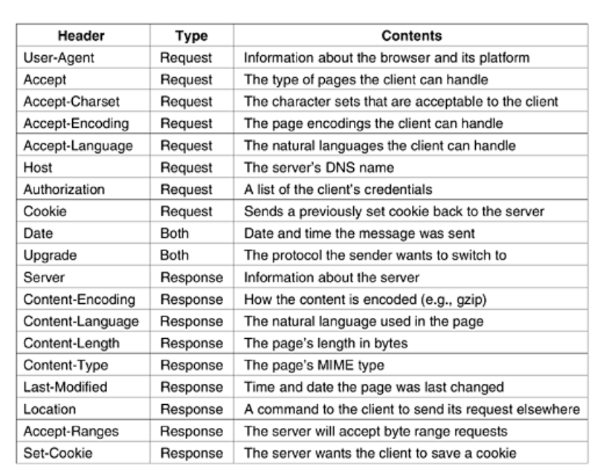
HTTP-The Hypertext Transfer Protocol
Message Headers

Slide 16
HTTP-The Hypertext Transfer Protocol
HTTP is used in everyday web interactions. HTTP enables the exchange of data between clients and servers, supporting tasks from simple web page retrieval to complex API interactions. Understanding these HTTP operations helps in developing, debugging, and maintaining web applications.
telnet www.ietf.org 80 >log
GET /rfc.html HTTP/1.1
Host: www.ietf.org
Close
This sequence of commands starts up a telnet (i.e., TCP) connection to port 80 on IETF's Web server, www.ietf.org.
The result of the session is redirected to the file log for later inspection. Then comes the GET command naming the file and the protocol.
The next line is the mandatory Host header. The blank line is also required. It signals the server that there are no more request headers.The close command instructs the telnet program to break the connection.

Slide 17
HTTP-The Hypertext Transfer Protocol
HTTP/1.1 vs. HTTP/2
HTTP/1.1:
Introduced persistent connections, pipelining, and chunked transfer encoding.
Each request and response are handled sequentially over a single TCP connection.
HTTP/2:
Introduced multiplexing, allowing multiple requests and responses to be sent simultaneously over a single connection.
Improved performance with header compression and reduced latency.
Security: HTTPS
HTTPS (Hypertext Transfer Protocol Secure) is HTTP with encryption. It uses SSL/TLS to secure data transmitted between the client and server, ensuring confidentiality, integrity, and authentication.

Slide 18
Telnet
Telnet is a network protocol and a command-line tool used for interacting with remote systems over a network. It operates on TCP and provides a way to connect to and control remote computers, typically through a command-line interface.
Overview of Telnet
Protocol: Telnet is a protocol used for remote access to command-line interfaces on remote computers.
Port: It typically operates on TCP port 23.
Text-Based: The communication happens in a text-based format, allowing users to send commands and receive responses.

Slide 19
Telnet
How Telnet Works
Establishing a Connection:
A Telnet client initiates a connection to a remote Telnet server using the IP address or hostname and port number (usually port 23).
Example command to connect to a Telnet server:
telnet example.com 23
Authentication:
Upon connecting, users are usually prompted to enter a username and password to authenticate themselves.
Command Execution:
Once authenticated, users can execute commands on the remote system as if they were using its local terminal.
Session Management:
The Telnet session allows users to interact with the remote system's command line, run applications, and manage files.
Closing the Connection:
To end the Telnet session, users can type exit or logout, or close the terminal window.

Slide 20
Telnet
Example Usage of Telnet
Connecting to a Remote Server:
telnet example.com
This command attempts to connect to example.com on the default Telnet port (23). If you want to specify a different port, you can include it after the hostname:
yaml
telnet example.com 2323
Testing Connectivity:
Telnet can be used to test connectivity to a specific port on a server. For example, to check if a web server is responding on port 80:
telnet www.example.com 80
If the connection is successful, you can manually type HTTP commands like GET to test responses.
Remote Access:
After connecting, you might be prompted to log in:
makefile
login: johndoe Password: [YourPassword]
Once logged in, you can execute commands on the remote system.

Slide 21
Telnet
Security Considerations
Lack of Encryption: Telnet transmits data, including login credentials, in plain text, making it vulnerable to eavesdropping and attacks.
Security Risks: Because Telnet does not encrypt data, it is generally considered insecure. It is often replaced by more secure alternatives like SSH (Secure Shell), which encrypts the data and provides additional security features.
Alternatives to Telnet
SSH (Secure Shell):
SSH is a secure alternative to Telnet that provides encrypted communication. It is widely used for secure remote access to systems.
Example command to connect via SSH:
ssh username@remotehost
Telnet is a historical tool for remote access and communication over TCP/IP networks. It allows users to connect to remote systems and execute commands through a command-line interface.
However, due to its lack of encryption, it has largely been replaced by more secure protocols like SSH. Despite its limitations, Telnet remains useful for testing network services and connectivity.

